Slide 1
Heart Disease Prediction System
1. Project Purpose
The purpose of this project is to develop a Machine Learning system that can predict the possibility of heart disease using patient health information.
Problem Statement
Heart disease is a common health problem, and early identification can help in better decision-making. This project uses patient medical data such as age, blood pressure, cholesterol, and maximum heart rate to predict whether heart disease may be present.

Slide 2
2. Objectives
The main objectives of this project are:
Heart Disease Prediction: Predict whether a patient may have heart disease.
Patient Data Analysis: Analyze important patient information such as age, blood pressure, and cholesterol.
Train a Machine Learning Model: Train a Random Forest model using patient data.
Show Prediction Probability: Show how likely the prediction is.
Interactive Interface: Provide an easy-to-use Streamlit web application for entering patient data and viewing results.

Slide 3
3. Dataset Details
The dataset contains 1,026 patient records and 14 columns. It includes different health-related features such as age, blood pressure, cholesterol, maximum heart rate, and other medical information. The dataset is used to train and test the Machine Learning model for heart disease prediction.
Dataset Size:
Total Rows: 1,026
Total Columns: 14
Target: Heart Disease Prediction

Slide 4
4. Data Preprocessing
Before training the Machine Learning model, the dataset was prepared for better results.
Missing Values: The dataset was checked for missing values.
Categorical Values: Categorical data was converted into numerical values so the model could understand it.
Features and Target: The input features were separated from the target value.
Train and Test Data: The dataset was divided into training and testing data.

Slide 5
5. Machine Learning Model
Random Forest Classifier
Random Forest is a Machine Learning algorithm that uses multiple Decision Trees to make a prediction.
In our project, Random Forest checks the patient's medical data and predicts whether the patient has heart disease or not.
Algorithm: Random Forest Classifier
Task: Binary Classification
Input: Patient medical features
Output:
  0 = No Heart Disease
  1 = Heart Disease
How it works
Random Forest creates multiple Decision Trees. Each tree makes its own prediction, and the Random Forest combines these predictions to give the final result.

Slide 6
6. Model Training
Model Training means teaching the model using our patient data.
Steps:
Dataset
↓
Clean & Prepare Data
↓
Split Data into Train & Test
↓
Train Random Forest Model
↓
Check Model Performance
↓
Save Model
↓
Use Model in Streamlit App

Slide 7
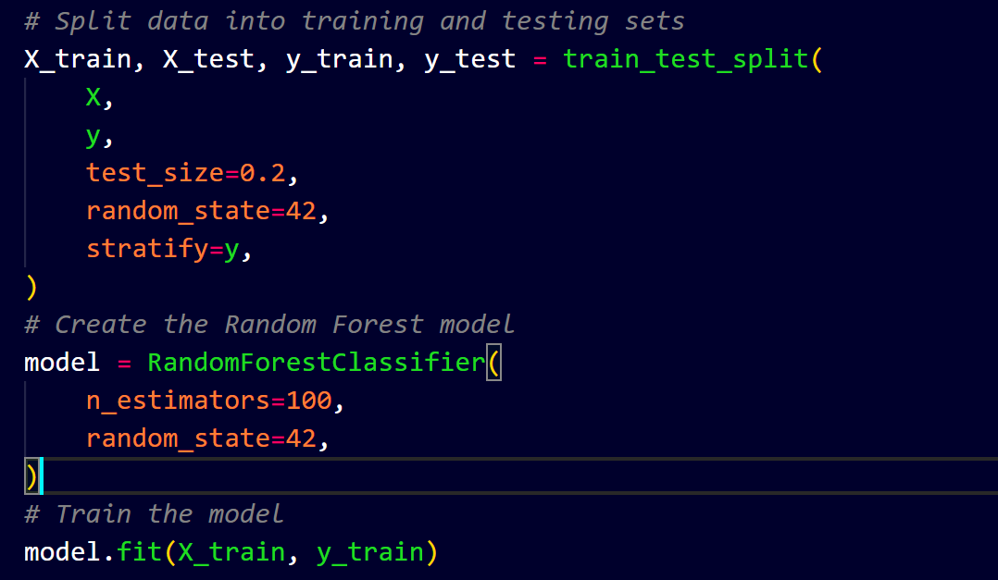

Slide 8
7. Model Evaluation
Model Evaluation means checking how well our model predicts heart disease.
Accuracy
Accuracy tells us how many predictions the model got correct.
Formula:
Accuracy = Correct Predictions / Total Predictions
Example:
Accuracy = 92%
This means the model made 92% correct predictions.

Slide 9
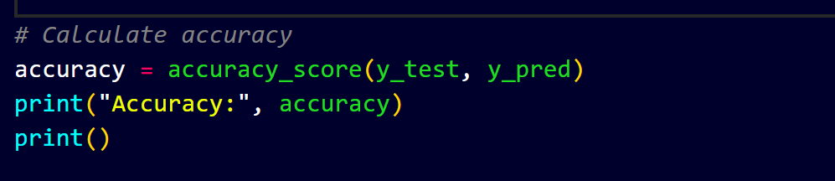


Slide 10
Precision
Precision tells us how many of the patients predicted as positive were actually positive.
Formula:
Precision = TP / (TP + FP)
Simple words:
Precision = Correct Positive Predictions / Total Positive Predictions
Recall
Recall tells us how many patients who actually have heart disease were correctly identified by the model.
Simple words:
Recall = Correctly Identified Patients / Total Actual Patients

Slide 11
F1-Score
F1-Score shows the overall performance of Precision and Recall together.
F1-Score = Combination of Precision and Recall
In your project:
F1-Score = 1.00 (100%)
Support
Support tells us the number of actual patients in each class in the test data.
In your report:
Class 0 → 100 patients — No Heart Disease
Class 1 → 105 patients — Heart Disease
Total → 205 patients

Slide 12
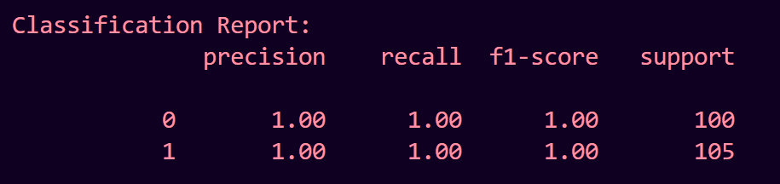

Slide 13
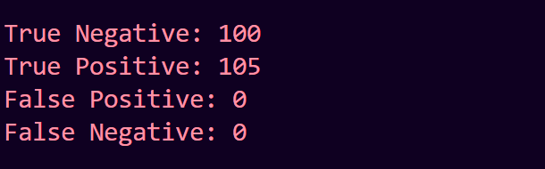
Confusion Matrix
Confusion Matrix shows how many predictions were correct and incorrect.
TP (True Positive): Patient has heart disease → Model predicts heart disease.
TN (True Negative): Patient has no heart disease → Model predicts no heart disease.
FP (False Positive): Patient has no heart disease → Model predicts heart disease.
FN (False Negative): Patient has heart disease → Model predicts no heart disease.

Slide 14
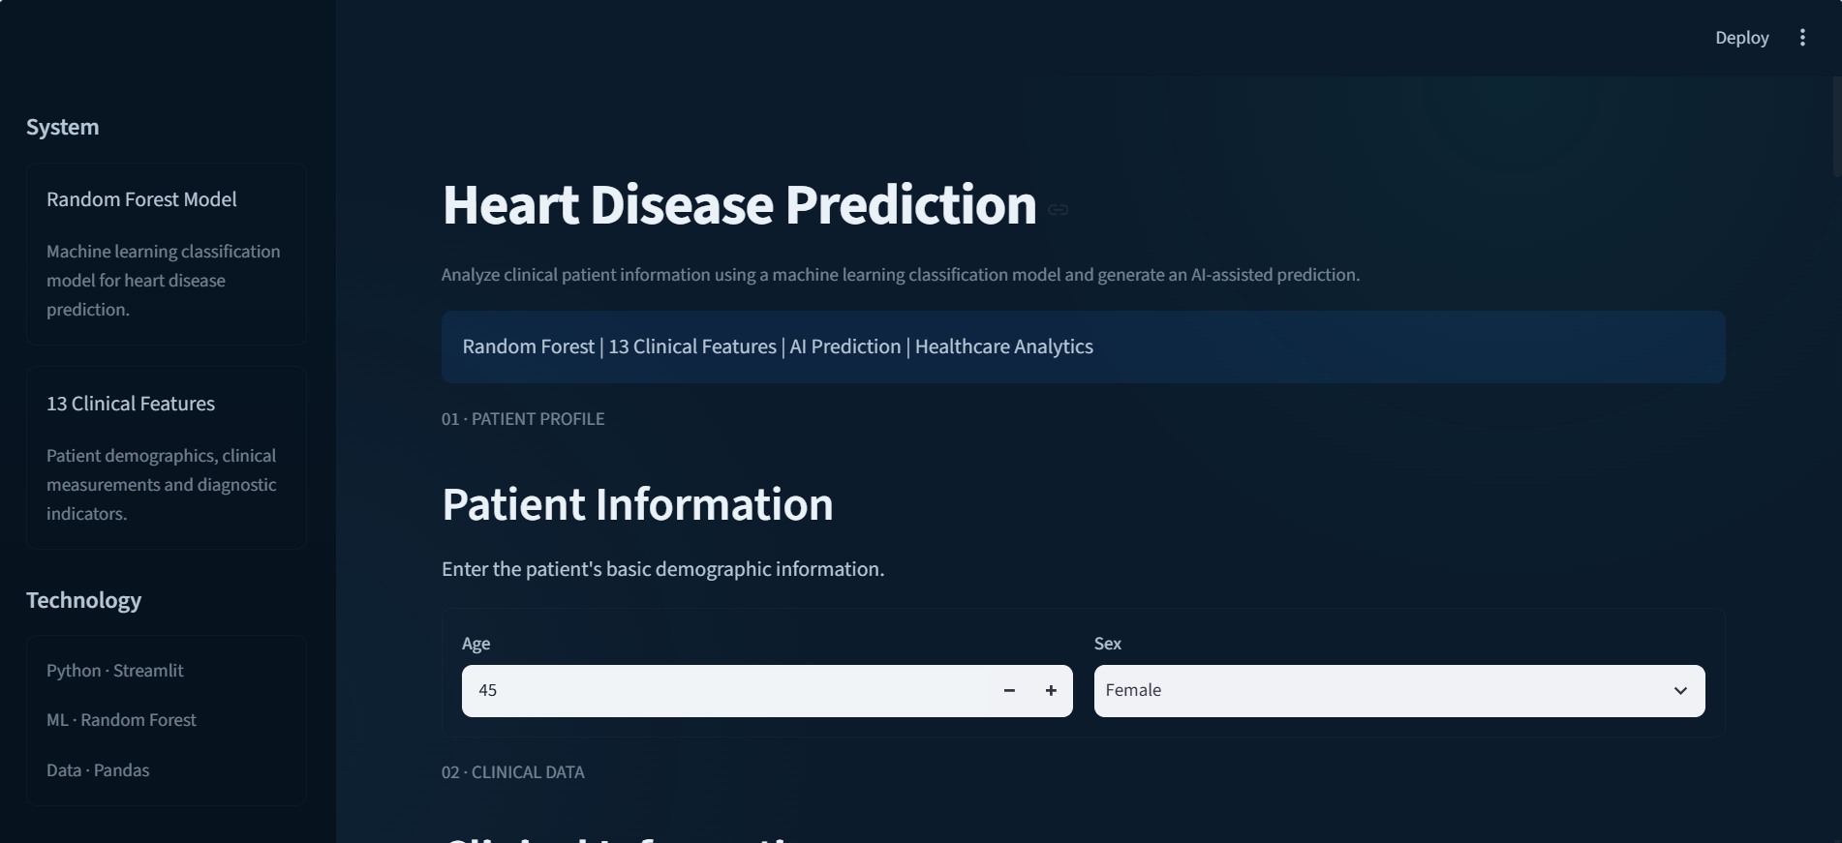
9. Streamlit Application

Slide 15
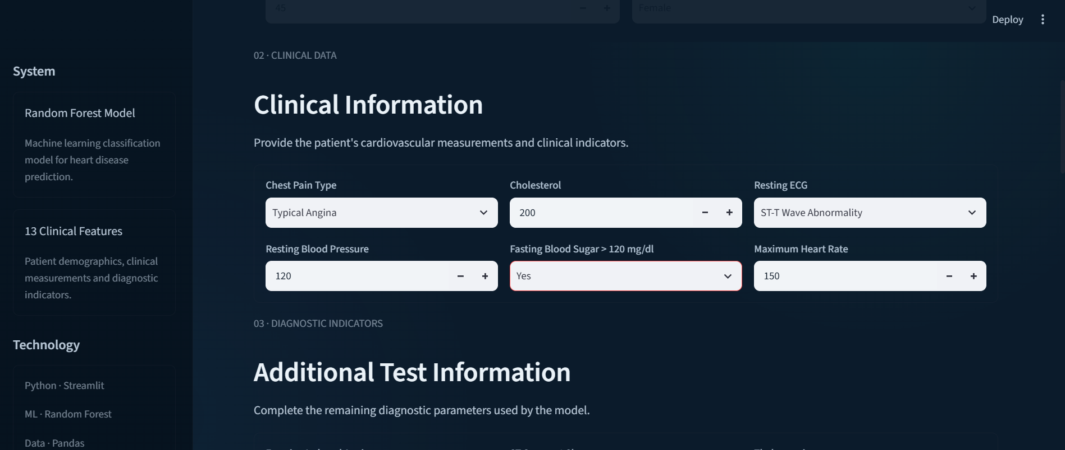

Slide 16
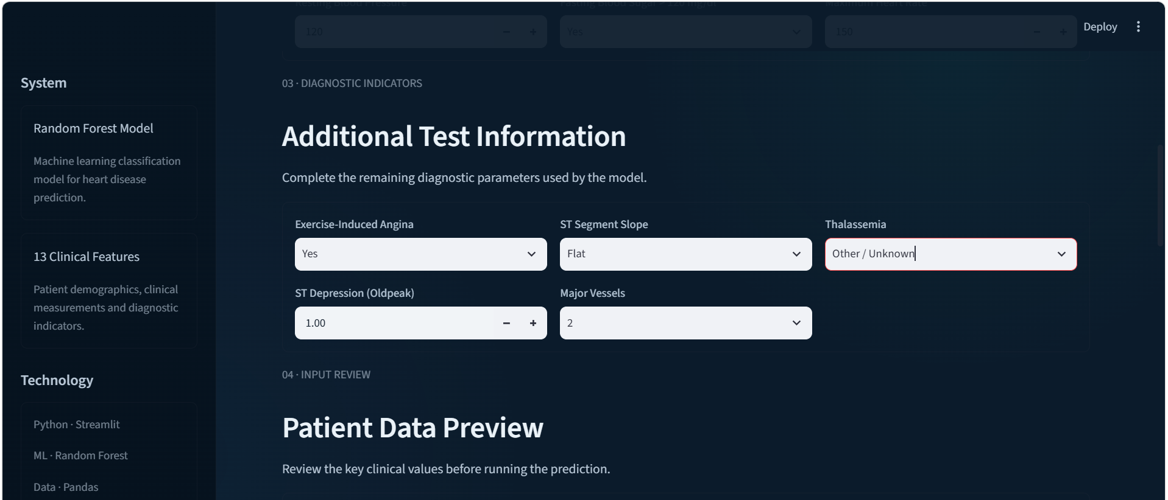

Slide 17
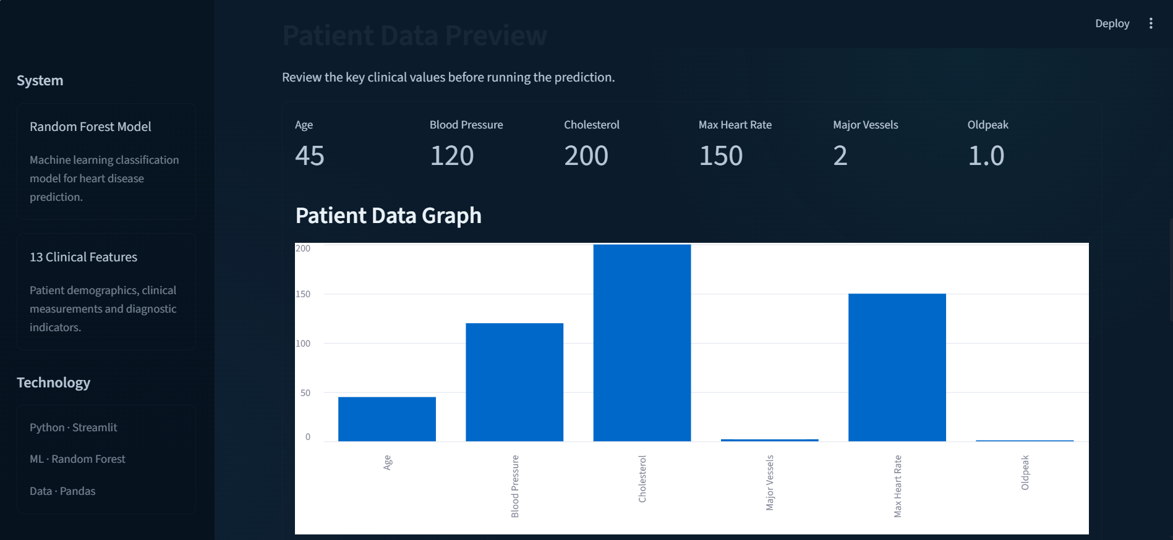

Slide 18
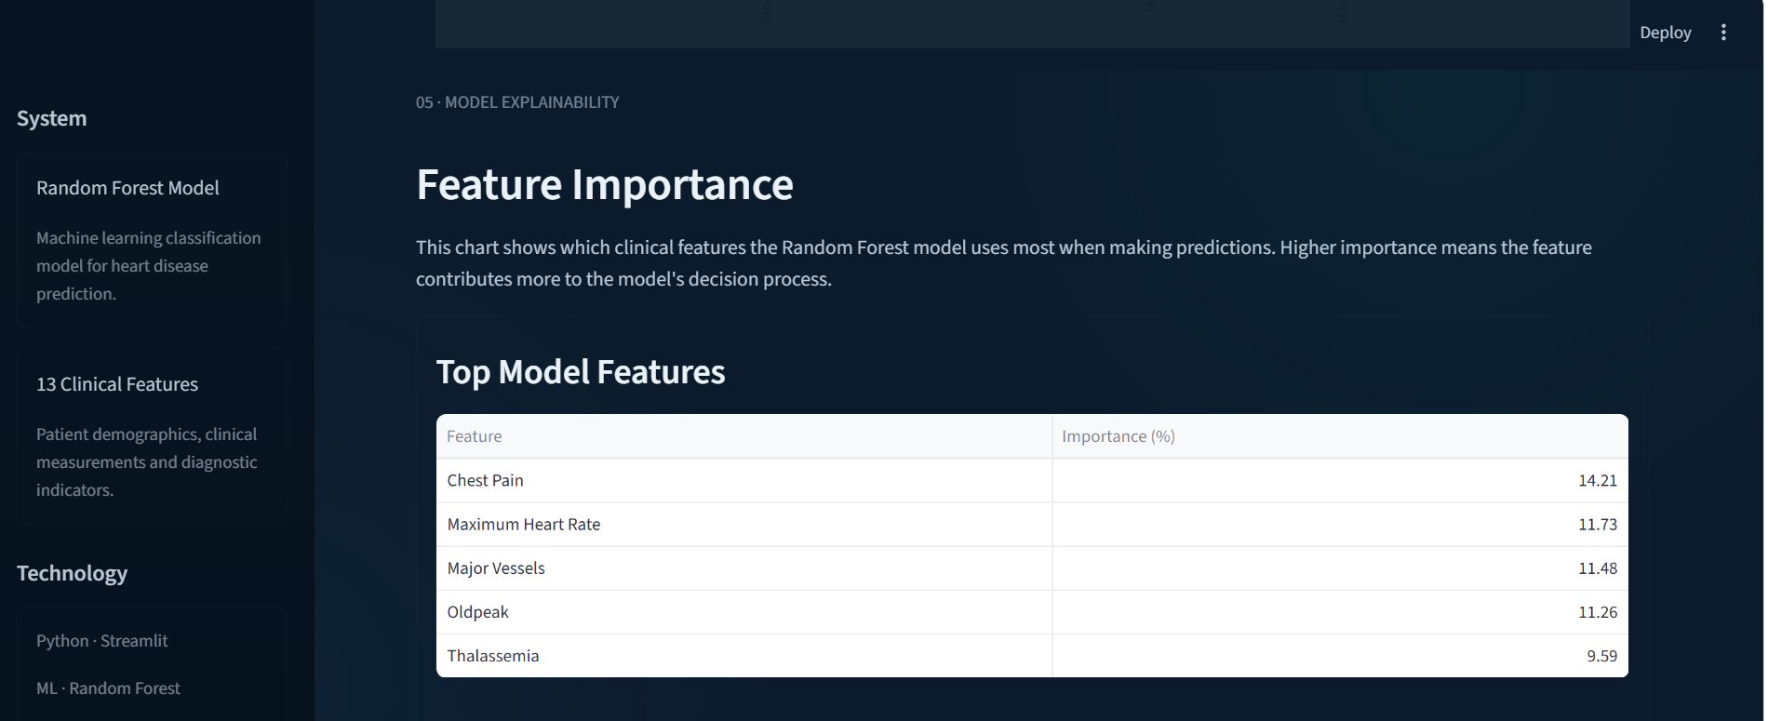

Slide 19
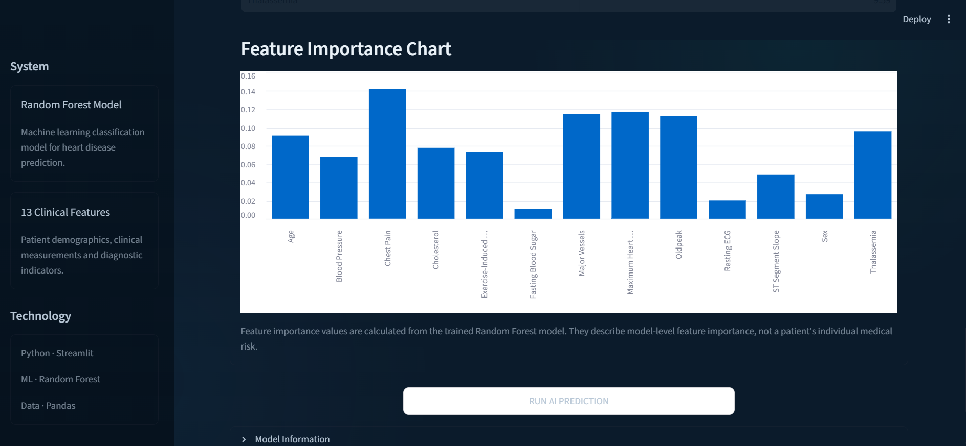

Slide 20
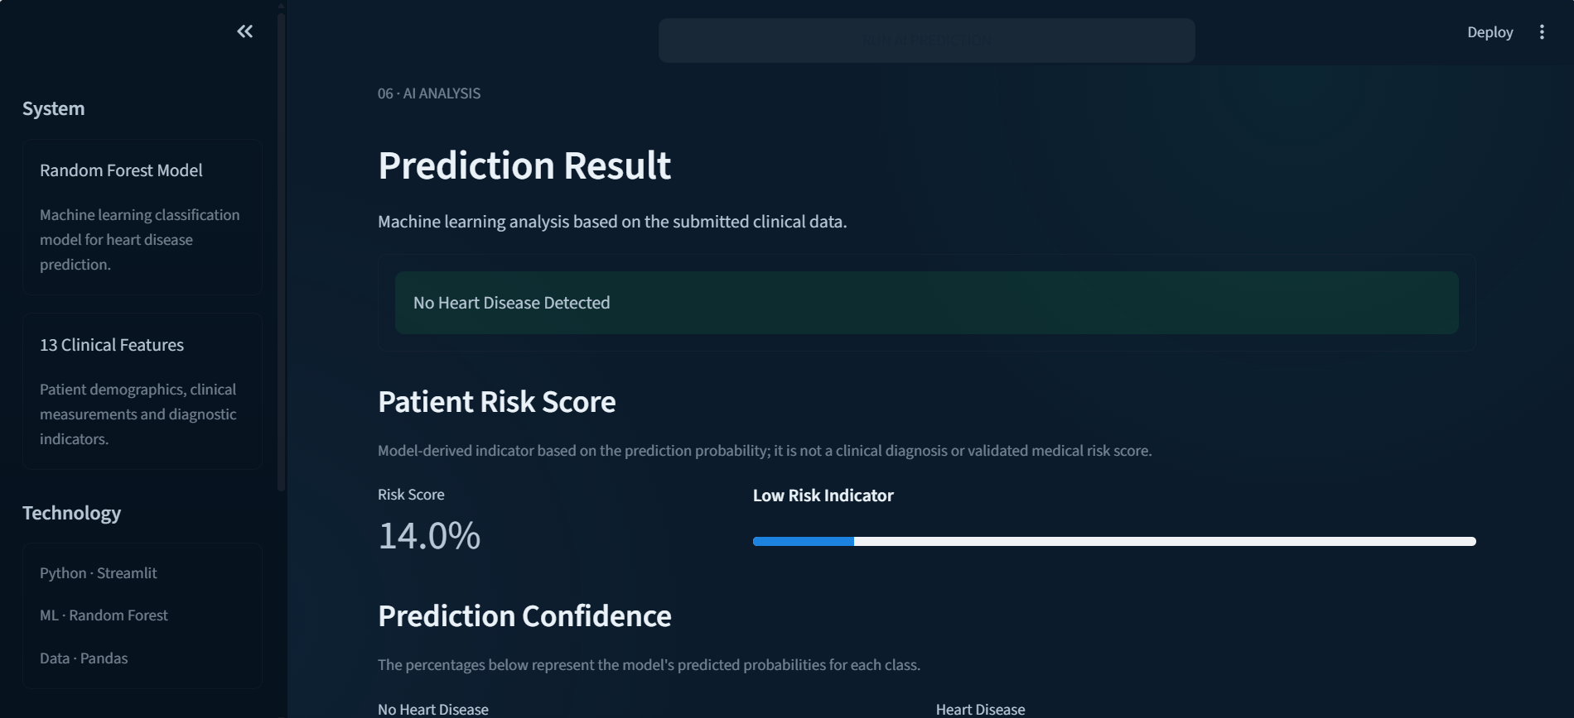

Slide 21
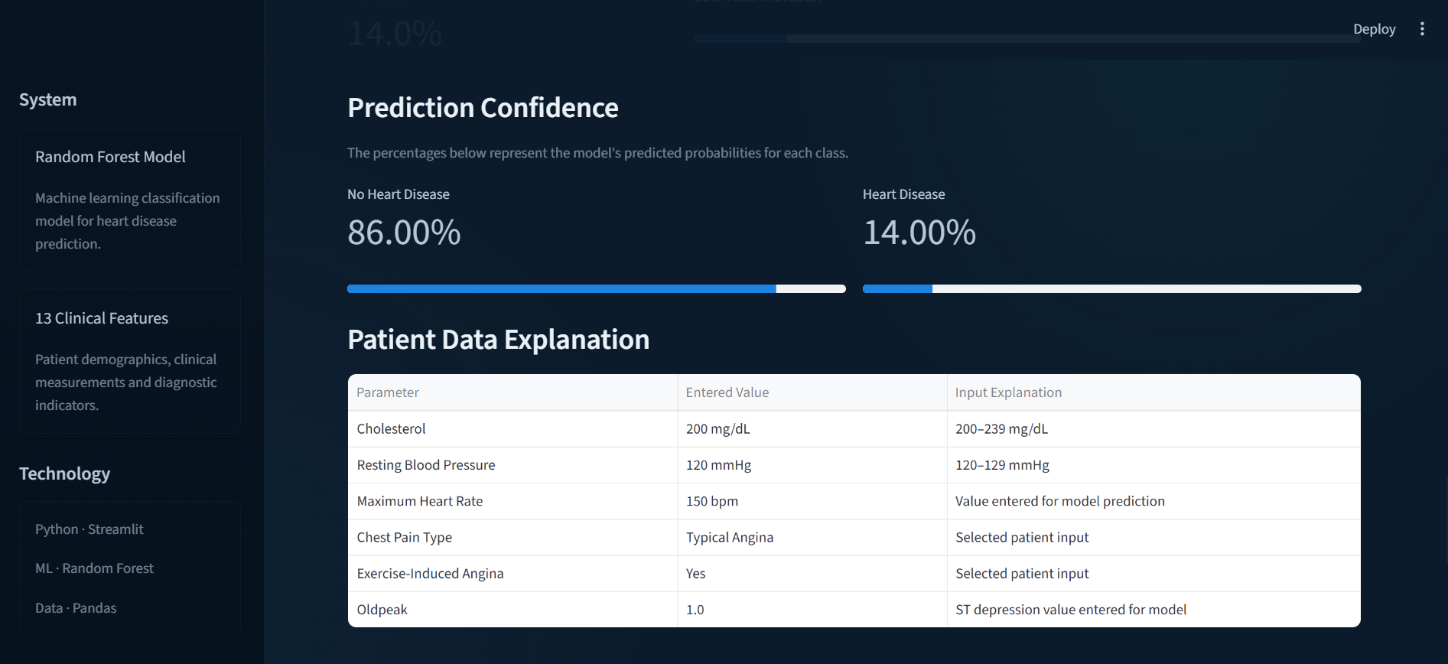

Slide 22
